Slide 1
Nurture Community
P-13 Milestone 3
Team Members:
Anubha Sharma
Arshdeep Kaur
Harjinder Gill
Tanya Agarwal
Shafkat Waheed
Roxy Leonard Palma
Priyam Dua
Avinash Gupta
Project Director: Daniel Obawole
Customer: Vinay Manjunath

Slide 2
Targets of Milestone 3
Localized Search
Create Restaurant Profile Page
Read, Update and Delete Quantity of the food
To Create a CONTACT US page

Slide 3


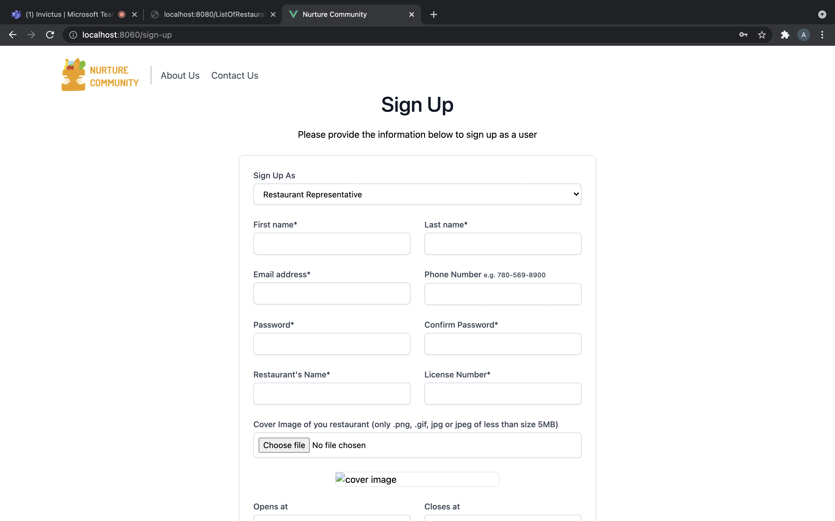
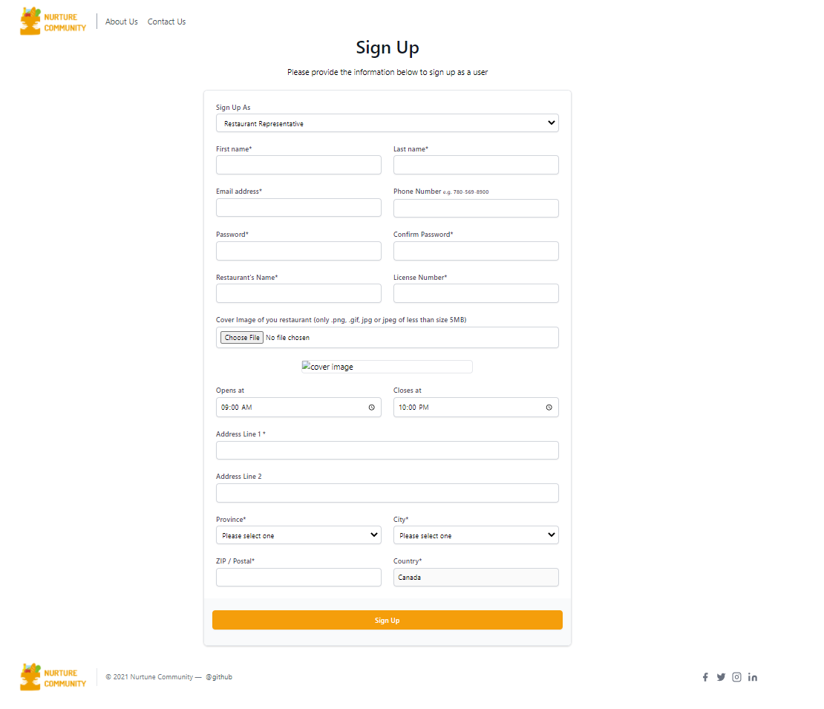

Signup Page for Restaurant representative
Changes made in our Sign-up page
After successful registration, the Signup page emails the registered user and redirects to the Login page to check the Id and password entered in the Signup page.
Responsive Design: The page responds to changes in browser width by adjusting the placement of the input tabs and the buttons to fit in the available space.

Slide 4
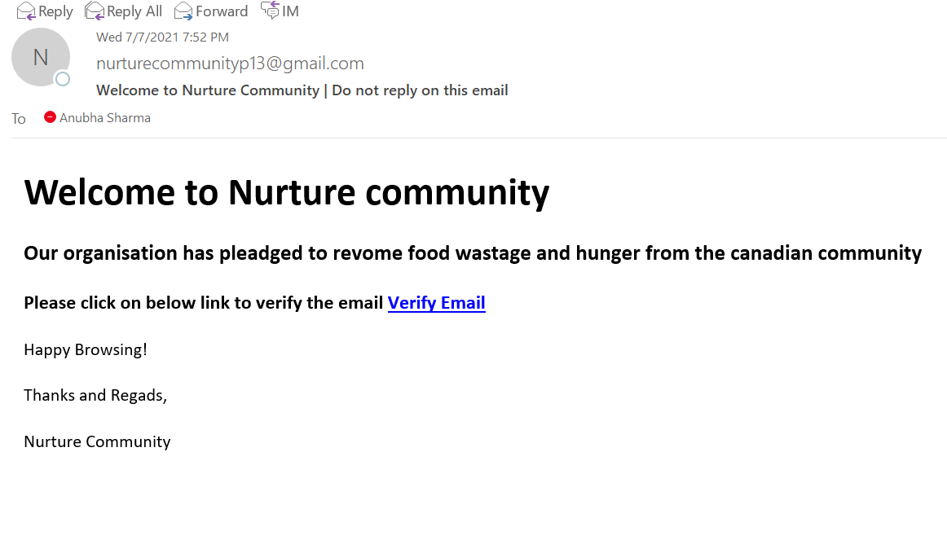
Validation On Sign Up Page
Changes made on Sign-up page :
After the successful signup an email is sent to the user for the verification process.
Basic email validation and minimum password length of 8 digits.
Password is stored in the encrypted format in the database for security purpose.

Slide 5
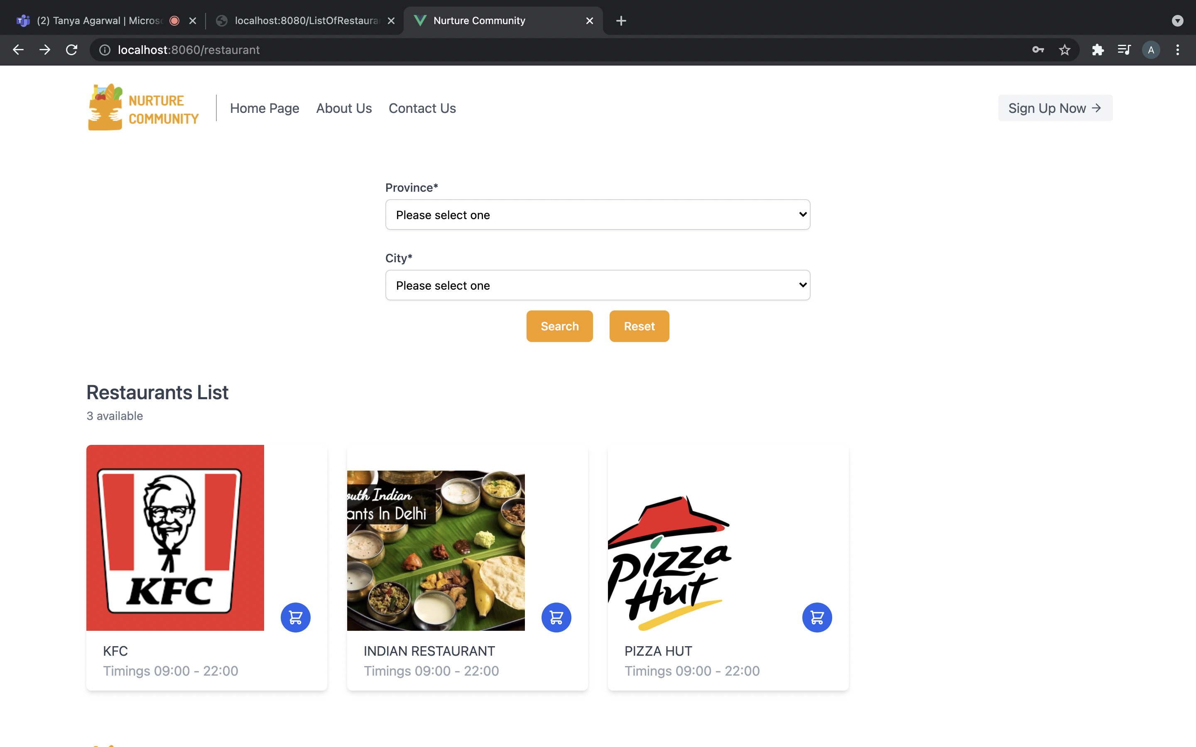
Localized Search ( Localization by City)
Localization is the process of refining website content either by city and province to provide the most useful and relevant experience for users.
We have done localization by City and Province.
When someone searches for a city and a province, they'll find the restaurants nearby them.

Slide 6
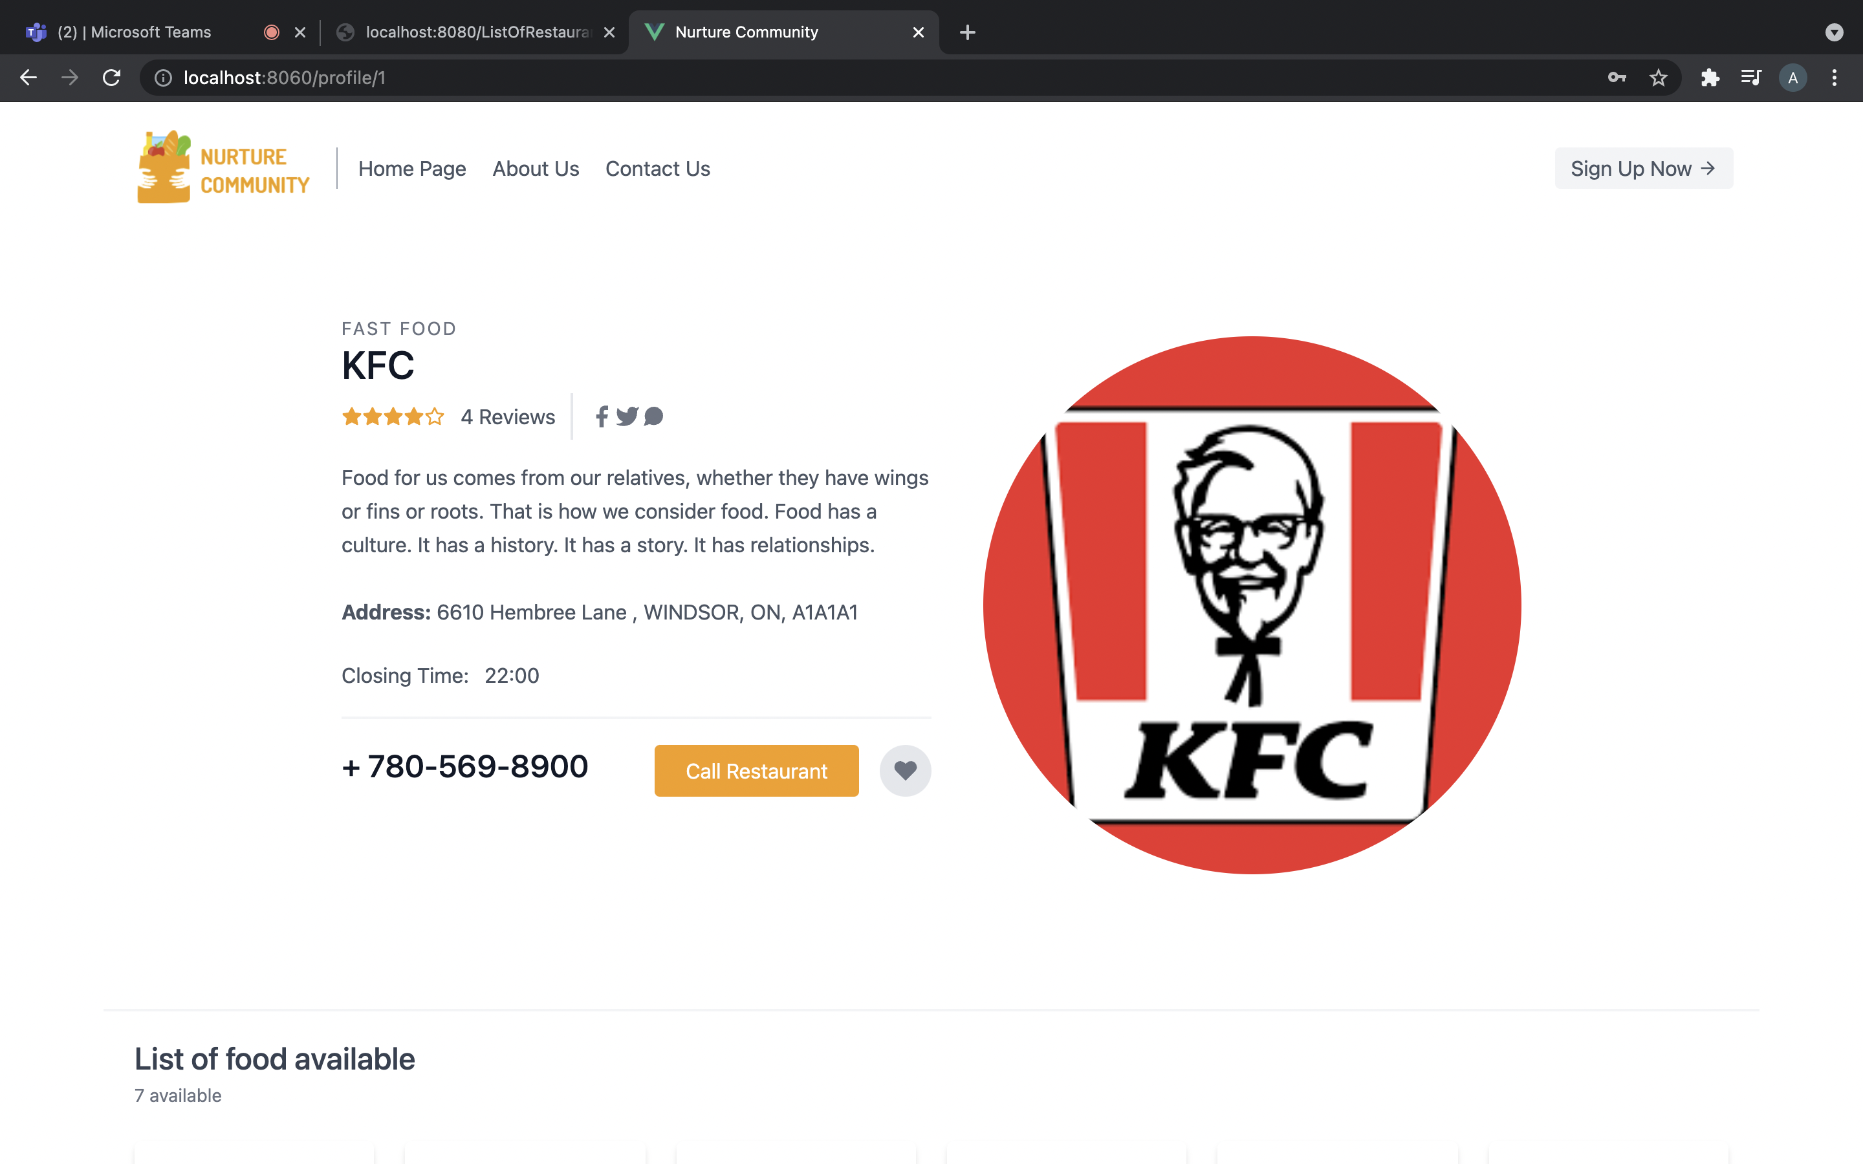
Restaurant Profile Page
In this, we can see the available food items by the restaurant
Also, All the details of the restaurant are visible.
For instance, Restaurant Name, Opening and closing time, Address, available food items and contact information

Slide 7
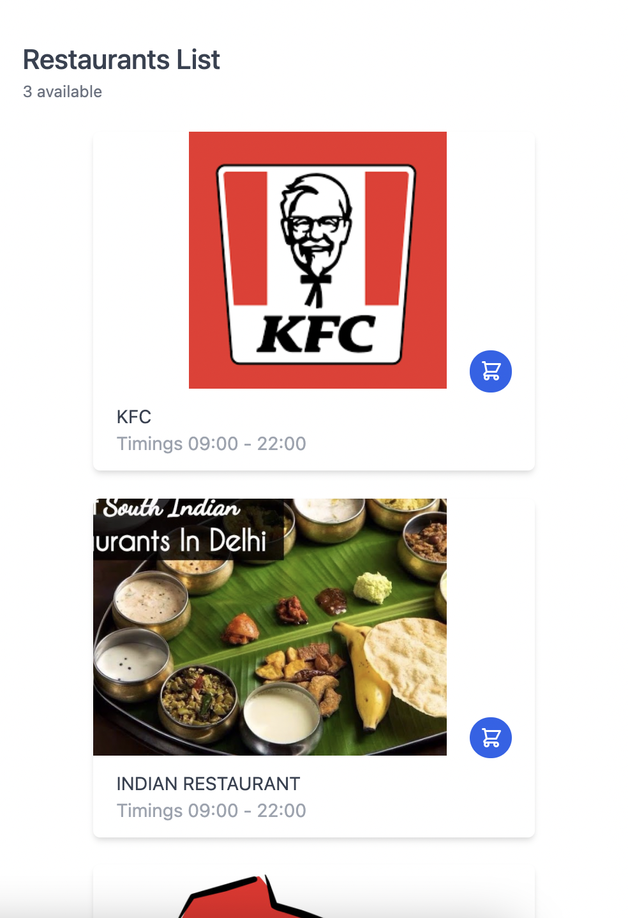
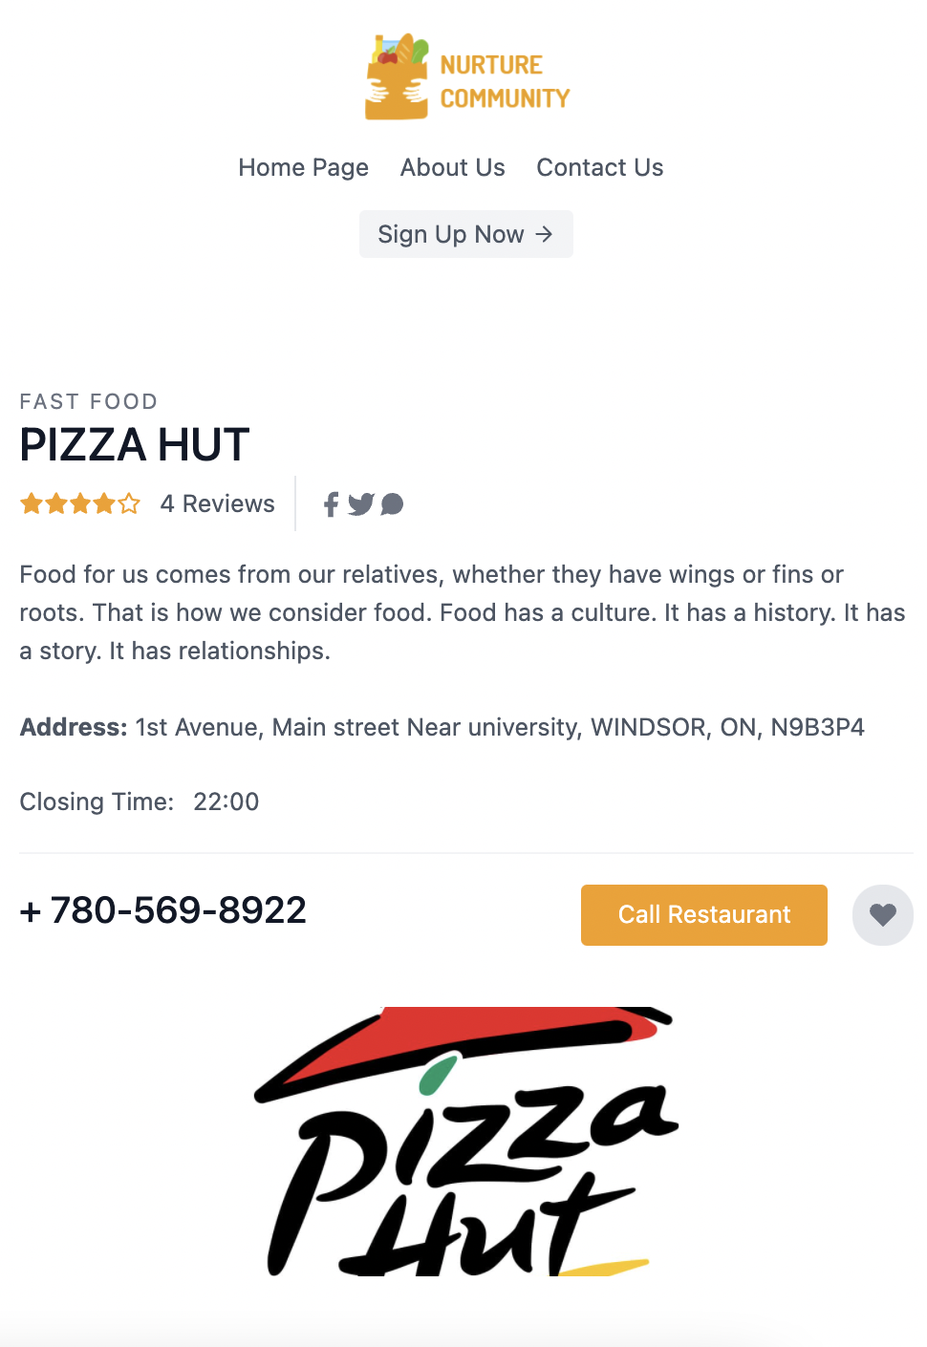
Mobile View of Restaurant Profile Page:

Slide 8
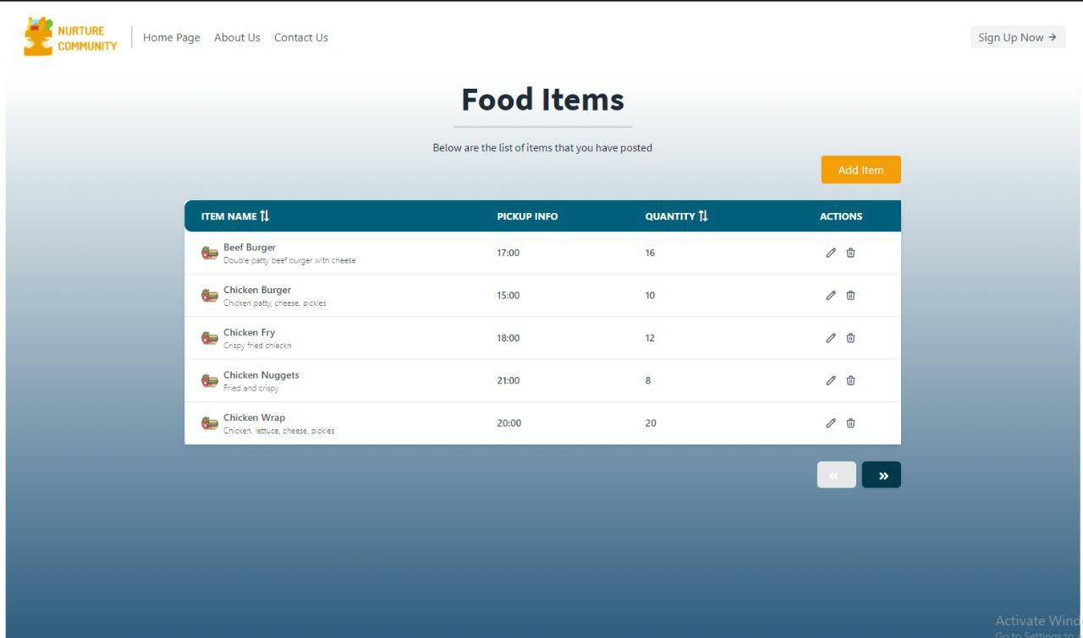
Test Page for Food Items

Slide 9
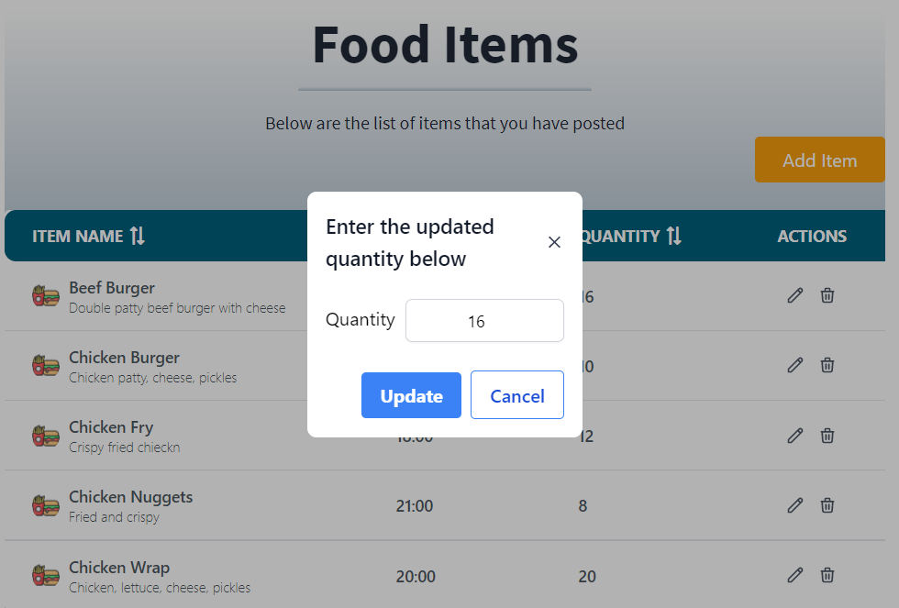
Update/delete the Quantity of food
The Restaurant can update or delete the quantity of food according to the availability.
The updates will be real time.

Slide 10
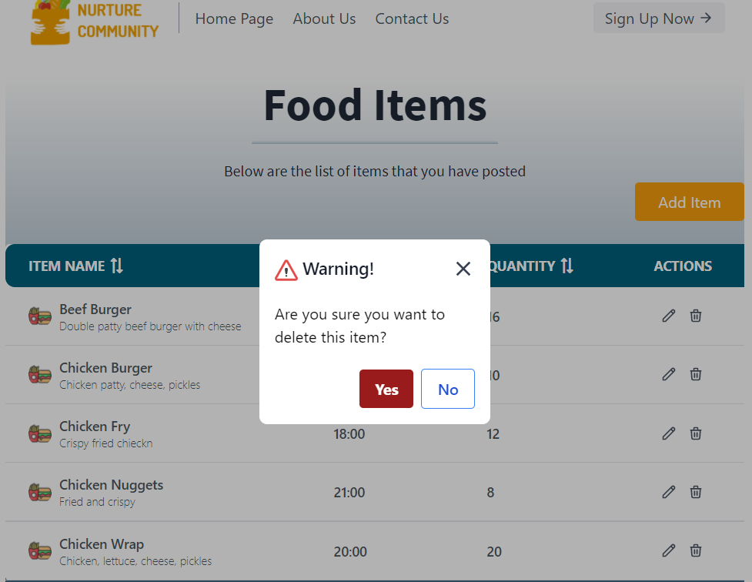

Slide 11
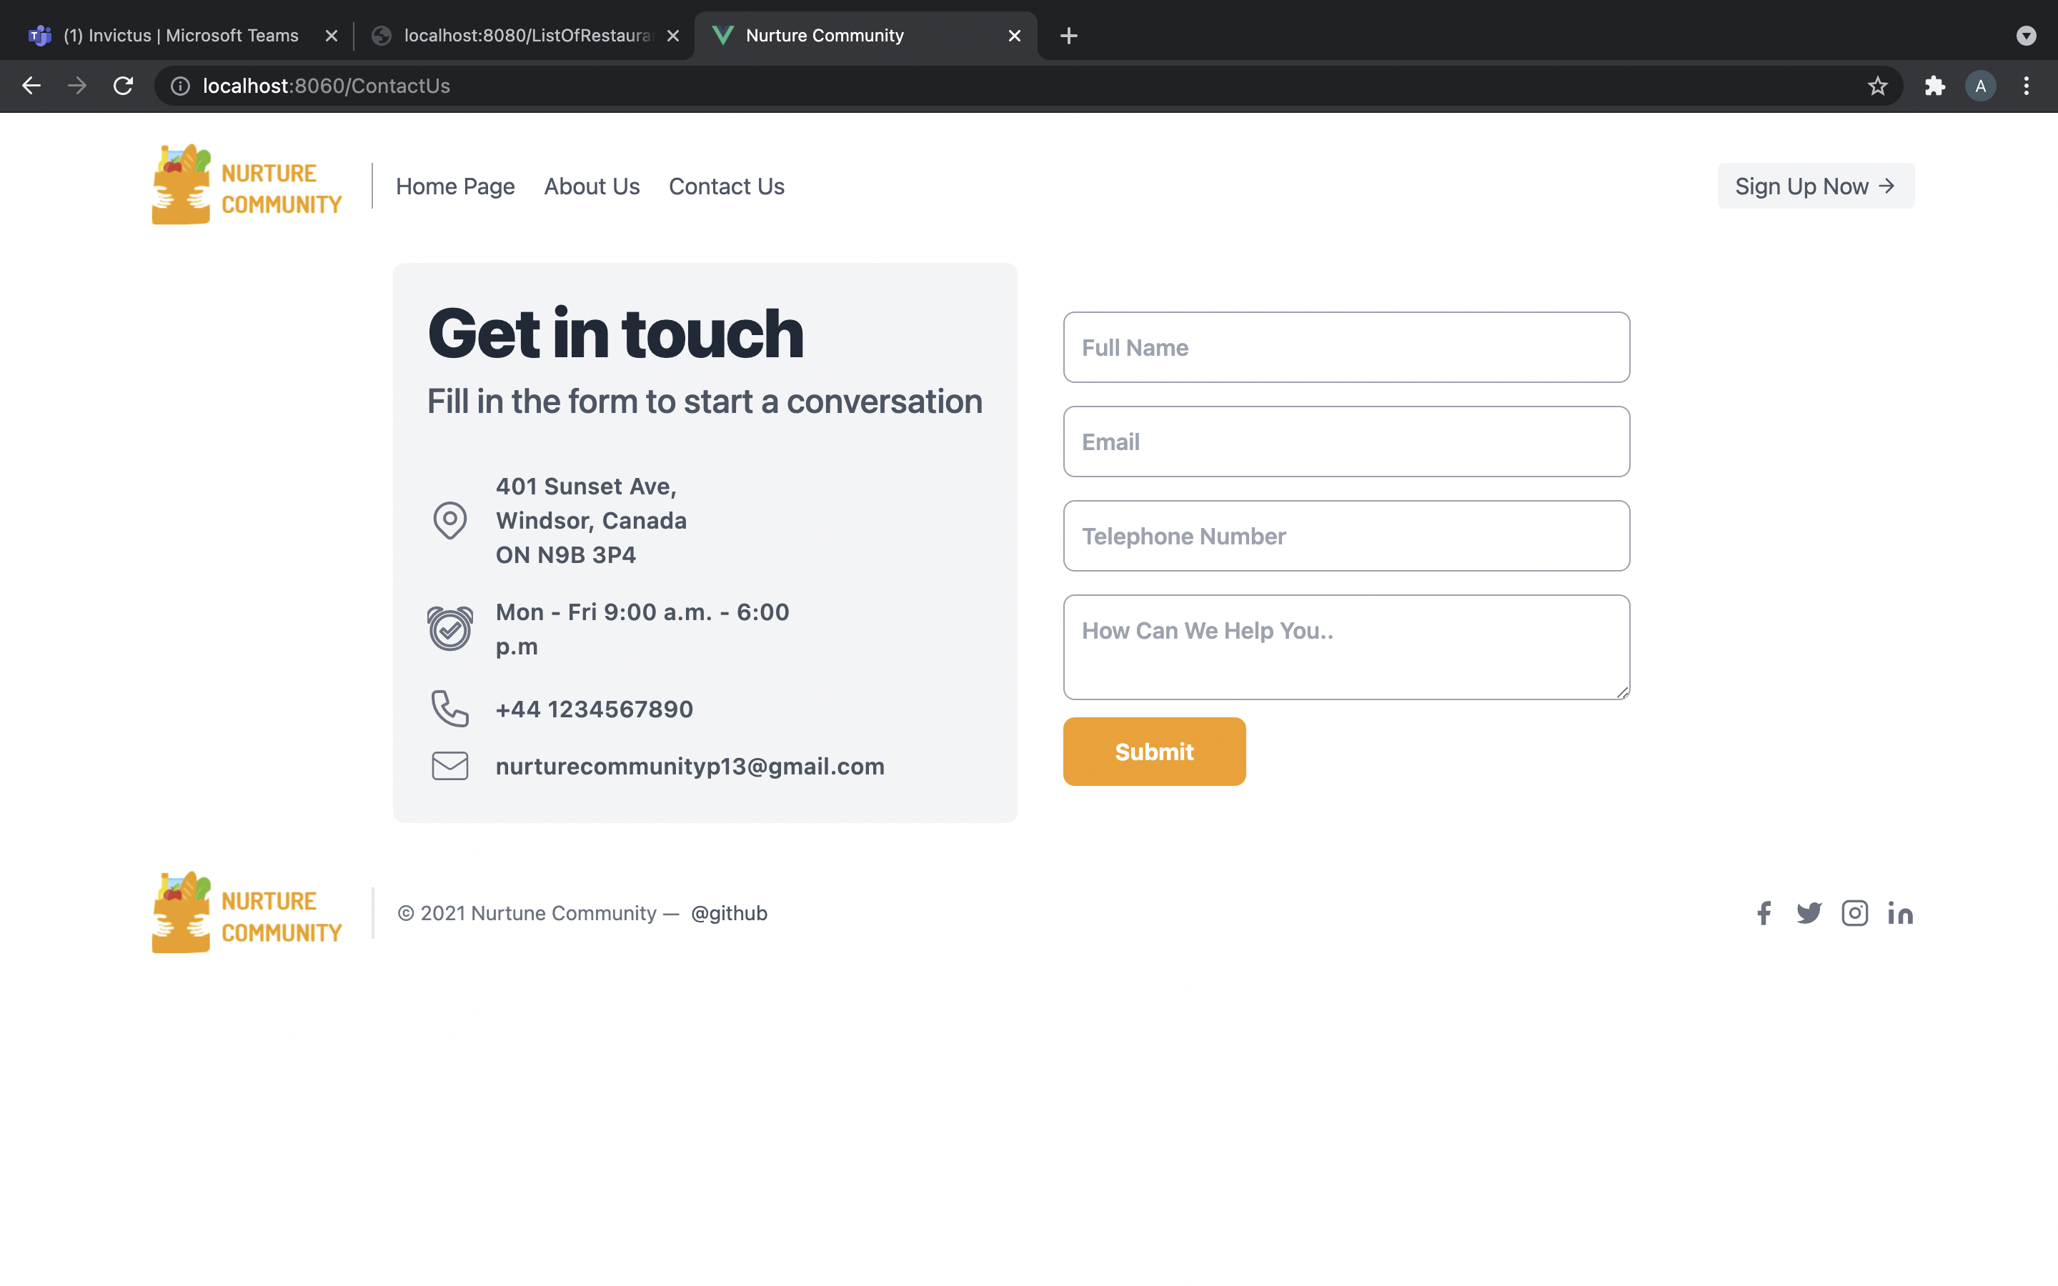
CONTACT US PAGE
Online interaction with potential customers is like speed dating. it is an absolute necessity to provide the most fundamental information to prospective customers in the most efficient way possible: a “Contact Us” page.
It is the easiest way our audience can reach us.
Our Contact Us page provides our email address, Telephone number and available timings, so that he can directly contact us regarding any query.
Further, the user can also send us a message by filling his details which includes Full name, email address, telephone number and a text box where he can write his concern.

Slide 12
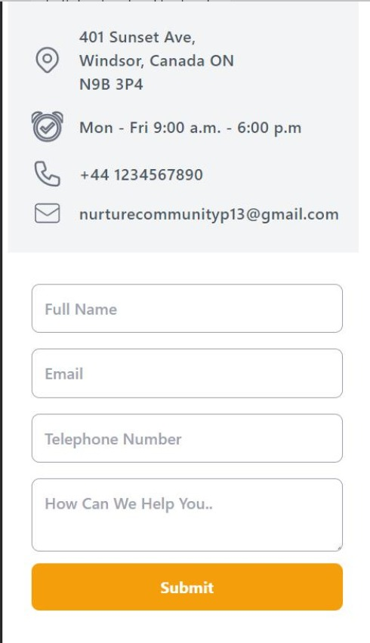
Mobile View of Contact Us Page

Slide 13


